Slide 1
Developer Tools
Front-End Web Development

Slide 2
Lesson 18 Change Log FEWD 3.1 - 3.2
No changes.
Share how the lesson went through our Instructor Lesson Exit Ticket - the Curriculum Feedback form: http://ga.co/curriculum-feedback

Slide 3
Developer Tools
Overview
This lesson introduces the command line and GitHub, culminating in deployment with GitHub Pages.
Learning Objectives
In this lesson, students will:
Use GitHub for version control and code collaboration.
Execute commands from the command prompt for increased control of file systems.
Duration: 180 minutes

Slide 4
Suggested Agenda
Time | Activity | Purpose
0:00–0:15 | File Systems | Introduce file system terminology.
0:15–0:45 | Text Editors | Make a recommendation for your students on a text editor and have them start learning how to develop locally.
0:45–1:15 | The Command Line | Explore the terminal and basic terminal commands.
1:15–2:30 | Git, GitHub Pages | Use just enough GitHub to deploy on GitHub Pages.
2:30–3:00 | Review and Final Project Preparation | Prepare students for the final project and presentations that will be due at the end of the course.

Slide 5
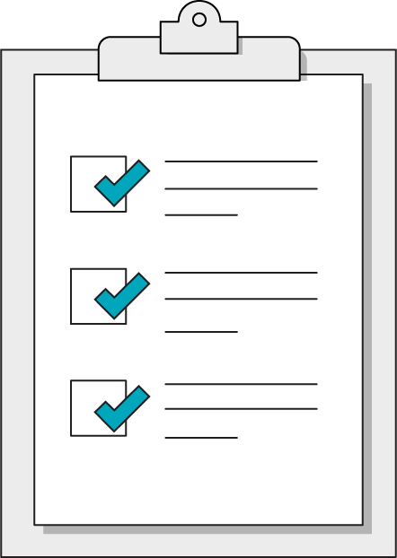
Today’s Learning Objectives
In this lesson, you will:
Use GitHub for version control and code collaboration.
Execute commands from the command prompt for increased control of file systems.
‹#› | © 2020 General Assembly
Notes:
DURATION: 1 minute
TEACHING TIPS:
Learning objectives help frame the lesson and give students an idea of what to expect.
Explain to students how this lesson fits into the overall course to help them make connections with content from other lessons.

Slide 6
File Systems
Front-End Web Development

Slide 7

File System Basics
Files are organized in hierarchies of folders.
Folders are organized in a modular way, with each folder representing a group of files with a similar purpose.
The lowest level of a file hierarchy is called the root.
System and user files are separated on computers. You should only deal with the user files.

Slide 8
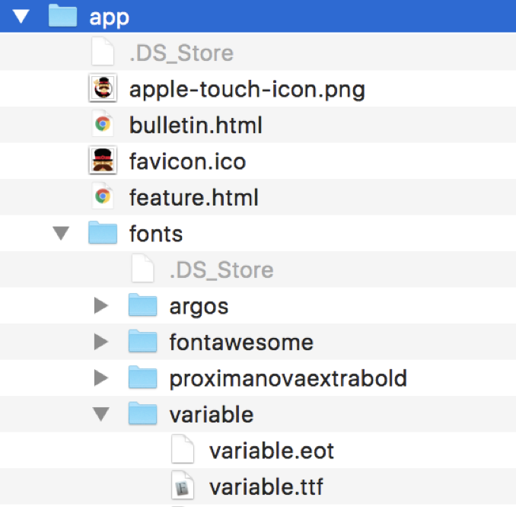

Slide 9
Let's Explore Our Computers
Open up Finder on a Mac or Windows File Explorer on a PC.
Set up your sidebar and toolbars.
Create a “sites” area on your computer.
Tweak system settings to create a productive workspace.
Spaces, dock, hot corners, and side-by-side windows can speed up navigation.
5 minutes
Notes:
TEACHING TIPS:
Feel free to show off any system customizations you have and explain why you chose to use them.
Lots of shortcuts are only learned by seeing that they are possible!

Slide 10
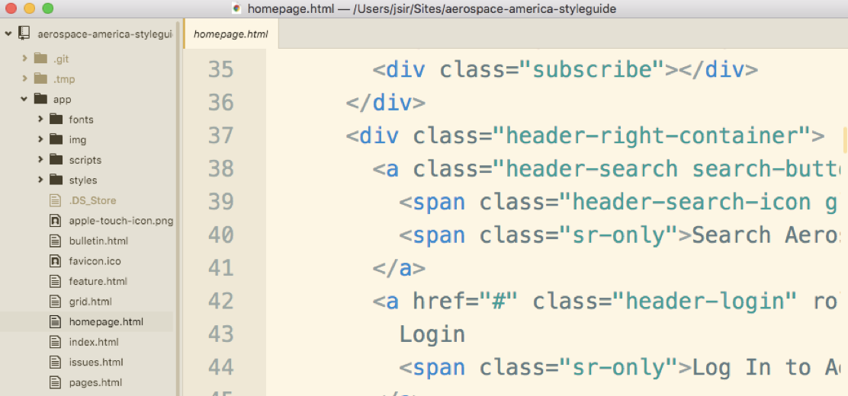
Text Editors

Slide 11

Text Editor Factoids
Text editors highlight text based on the programming language you are using.
They don’t use native file endings, so you have to know the file extensions with which to save your files (for our class: .html, .css, and .js).
They are close cousins to IDEs (integrated development environments). Text editors are good for front-end developers, while most back-end developers use IDEs.
Notes:
TEACHING TIPS:
Syntax highlighters and “linters” can be helpful but can also be overbearing.
Beginners tend to jump right into using a linter, then get intimidated by the many underlines for style reasons, so caution students not to overly rely on these tools.

Slide 12

Text Editor Options
Popular text editors include Sublime Text, Atom, and Visual Studio Code.
These are very similar tools — all show project files, highlight text, use modular plugin frameworks, and have powerful find-and-replace functions.
The biggest difference: Atom tracks Git changes in your file system.
Notes:
TEACHING TIPS:
Again, feel free to push your preference here.

Slide 13
Let's Look at Our Text Editors
Install and/or open up your program of choice.
Pick a theme.
Install a package, like language extensions or formatting tools.
Play around with some features (code folding, multi-cursors, split screen, Git status, find and replace, etc.).
15 minutes
Notes:
TEACHING TIPS:
Encourage students to share any cool features they found during this brief exercise period.

Slide 14
Command Line
Front-End Web Development

Slide 15
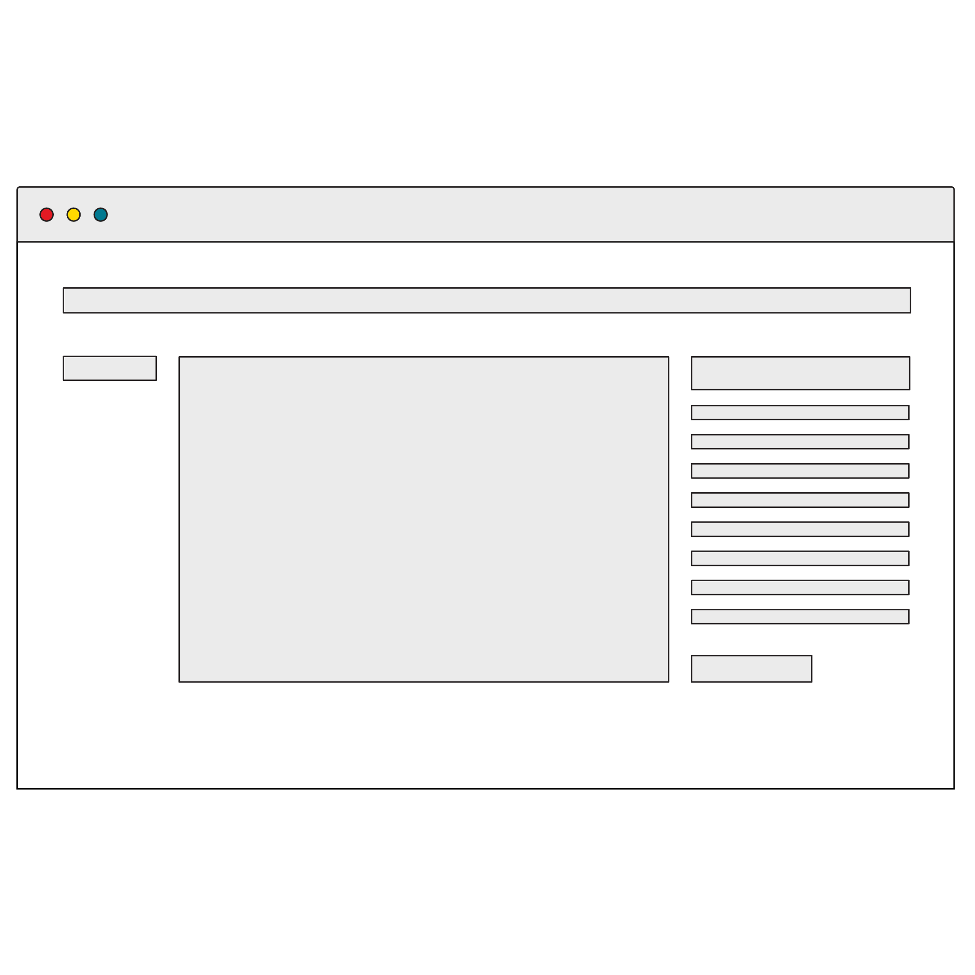
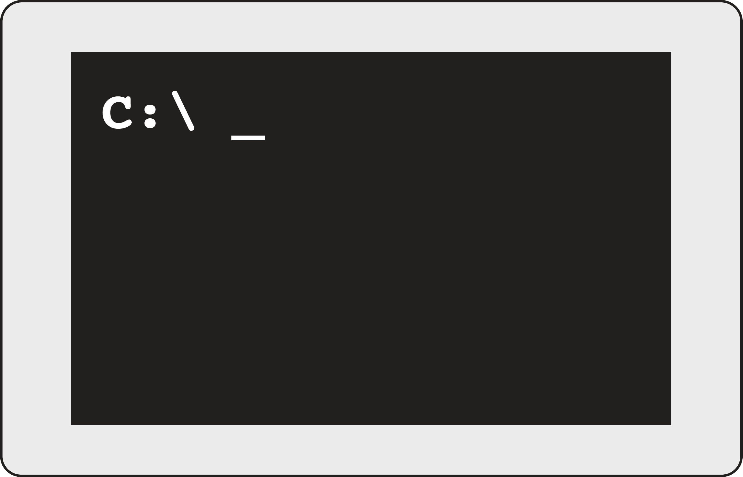
Command Line
Instead of graphical user interfaces like Finder or Windows File Explorer, programmers often use the command line — a direct, text-based system interface.
The command line allows you to navigate file systems, manipulate files, and execute programs.
GUI
CLI
Notes:
TALKING POINTS:
The command line will be vital for deploying applications.
There will be times you need to run commands on a remote computer, and the command line will be your only way in — you can’t bring your monitor and mouse to an AWS server farm!

Slide 16
Command Line Commands
UNIX (Mac) | Windows | Description
cd | cd | Change directories.
ls | dir | List the contents of the current directory.
pwd | cd | Print the location of the current directory.
mkdir | mkdir | Create a directory.
rm | rmdir | Delete a directory.
touch | echo | Create a file in the current directory.

Slide 17
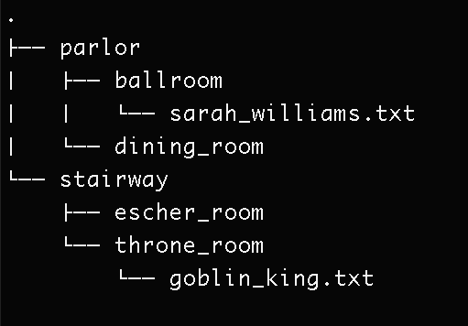
Build the Labyrinth
Use the command line to create this folder and file structure:
15 minutes
Notes:
TEACHING TIPS:
Demonstrate the answer after most students are complete, at about the 10-minute mark.

Slide 18
Git
Front-End Web Development

Slide 19
What Is Git?
Git is a database for all of your code (version control).
It's a particular kind of version control called distributed version control. This means multiple people can make edits to the same codebase at once.
This can be a hard concept to wrap your head around — see the diagram on the next slide.

Slide 20
Server Computer
Version Database
version 3
version 2
version 1
Computer A
Computer B
file
file
Version Database
Version Database
version 3
version 3
version 2
version 2
version 1
version 1
Image Source: git-scm.com

Slide 21
Git Commands
Command | Explanation
init | Creates a repository in the current directory (folder).
add | Stages the specified files to prepare them for a commit.
commit | Saves the current state of the repository.
push | Sends local repository contents to a remote repository.
clone | Downloads a remote repository onto your local machine.
pull | Syncs one version of a repository with another.
Notes:
TEACHING TIPS:
There’s a lot about GitHub that will be confusing at first. Demonstrating each of these steps and writing them on the board in sequence as a “cheat sheet” should be very helpful.

Slide 22
Getting started with Git and Gihub

Slide 23
git config --global user.name "Jane Smith"
git config --global user.email "Jane@youremail.com"

Slide 24
Clone - make a copy of a code repository on your local computer
Stage - setting aside specific changes you want to save in your next commit
Commit - saving or committing the changes in your files
Push - send your changes to the cloud (Github)

Slide 25
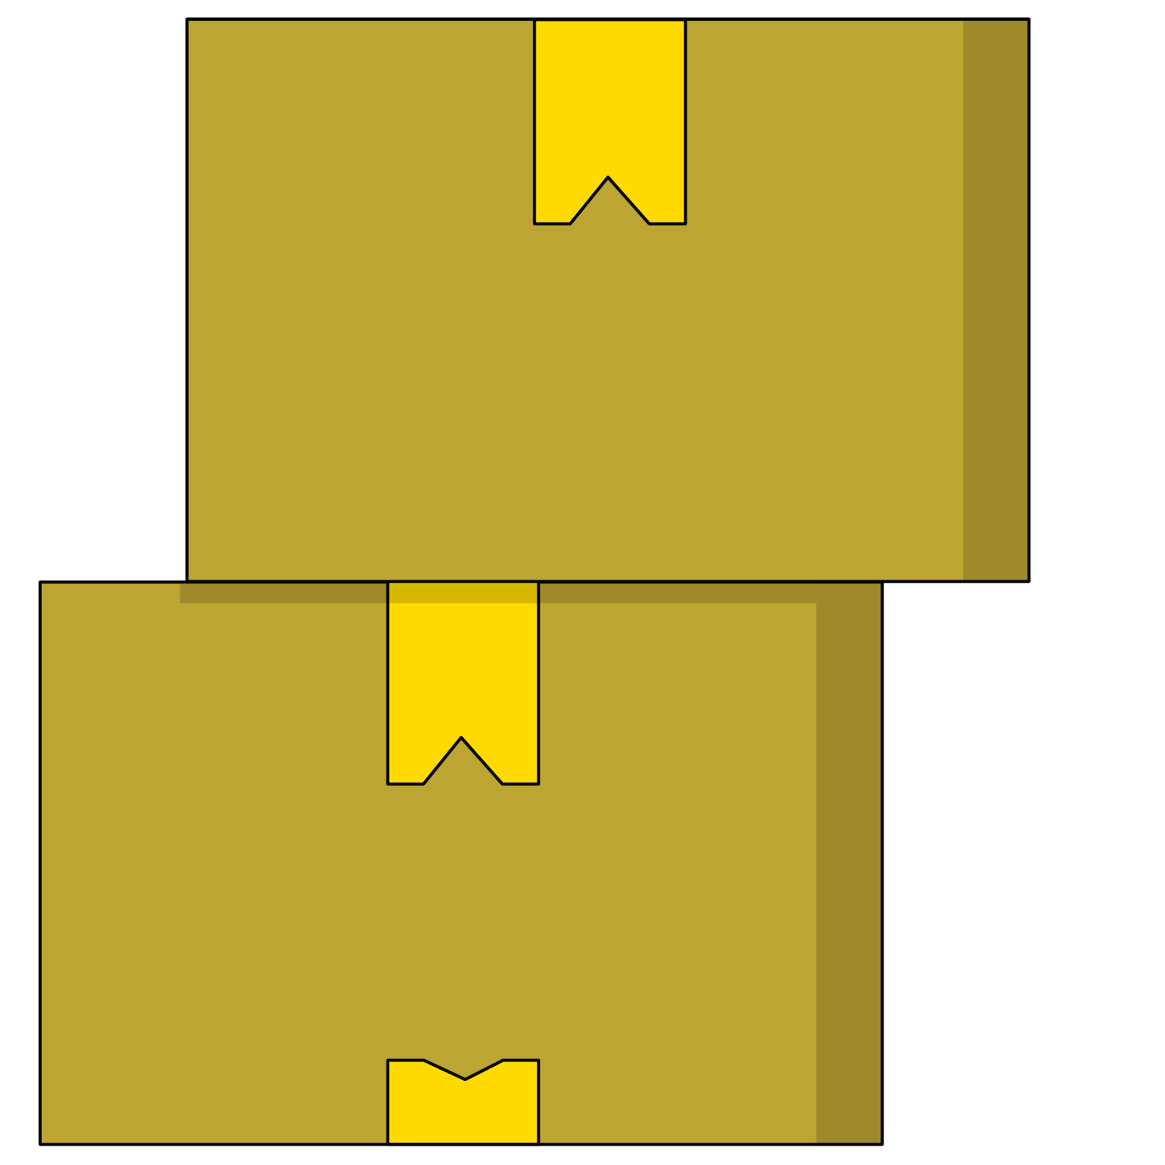
Storing a Project on GitHub
Choose any of the previous assignments or projects and store them in a repository using the command line, then push that repository to a repository on github.com.
Use your text editor to create the folder structure and copy files into a new folder.

Slide 26
Deployment With GitHub Pages
Front-End Web Development

Slide 27

GitHub Pages
Git is commonly used in the process of deploying projects to live servers on the internet.
It’s no surprise, then, that GitHub has its own built-in way to host projects directly from the repositories they already live in: GitHub Pages!

Slide 28
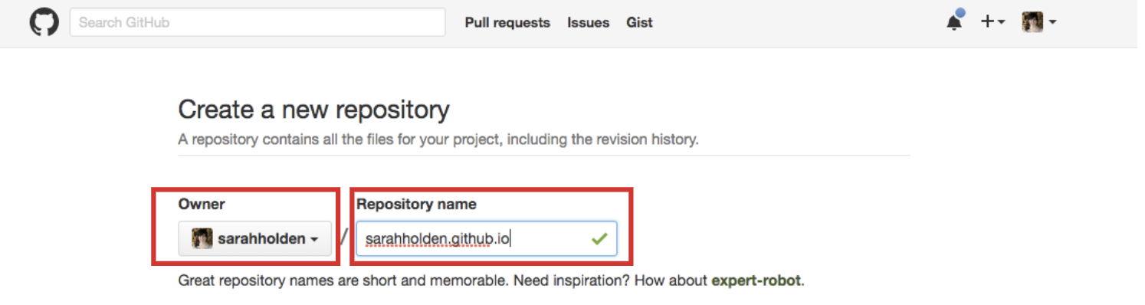
Make a Repository Based on Your Username
GitHub doesn’t just let you host every single project live. You’ll have to store the code you want to deploy in one specific repository, named after your username.

Slide 29
Push Your Code to the GitHub.com Repository
Once you’ve set up a remote repository on GitHub, create a local repository in your project directory and push it to GitHub.
Don’t worry — when you create a repository on github.com, it automatically shows you the command line commands needed to set things up.

Slide 30
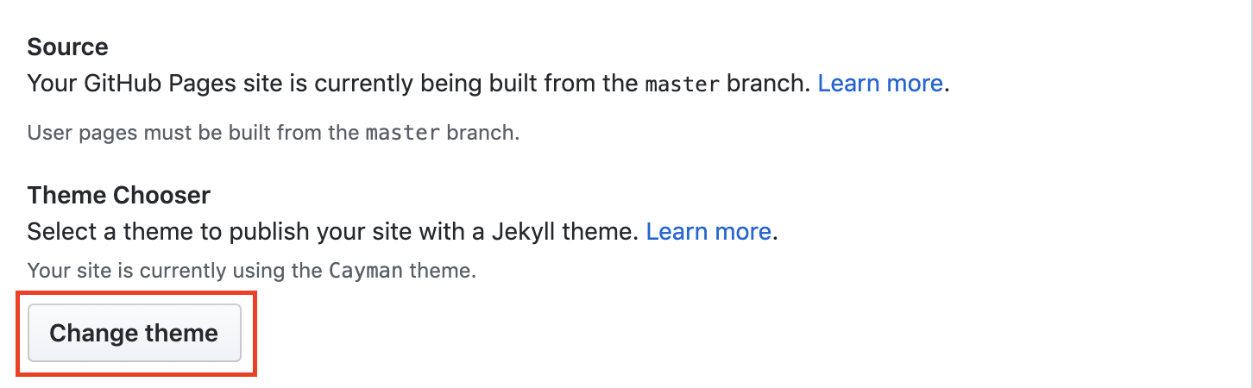
Choose a Jekyll Theme — Even If You Don’t Need It
GitHub Pages uses a static site generator called Jekyll to transform repositories into complete HTML sites. To satisfy its requirements, you’ll have to choose a Jekyll theme in the Settings > GitHub Pages menu of your repository.

Slide 31
Congratulations, Your Site Is Live!
It may take a few seconds, but you should be able to visit your site at your-username.github.io!
If you need to redirect the GitHub Pages project to a more friendly custom domain name, Pages provides ways of doing that as well.
There are other command-line tools that make deploying front-end websites a breeze: Netlify and surge.sh are both great alternatives to GitHub Pages.

Slide 32
Key Takeaways
For Next Time
CLI > GUI for Developers
Go Forth and Develop!
Many tools of the developer trade rely on command line interfaces.
Version control with Git is a key component of professional workflows.
Work on the final project for this class!
‹#› | © 2020 General Assembly

